Slide 1

Department of Computer Science, CUI Lahore Campus
Formal Methods in Software Engineering
By
Farooq Ahmad

Slide 2
Predicate Logic
Predicates, Quantified statements

Slide 3
Topics to be discussed
Predicates
Quantified statements
Negation of quantified statements

Slide 4
Predicate logic
One of the limitations with the propositional logic is that, while it allows us to argue about individual values, it does not give us the ability to argue about sets of values.
For the purpose of reasoning about sets of values, a more powerful tool than the propositional logic has been devised, namely the predicate logic.

Slide 5
Predicate
A predicate is a truth-valued expression containing free variables.
The variables allow the expression to be evaluated by giving different values to them. Once the variables are evaluated they are said to be bound.
A predicate is a sentence that contains a finite number of variables and becomes a statement when specific values are substituted for the variables.
The domain of a predicate variable is the set of all values that may be substituted in place of the variable.

Slide 6
Truth set
If P(x) is a predicate and x has domain D, the truth set of P(x) is the set of all elements of D that make P(x) true when they are substituted for x.
The truth set of P(x) is denoted as {x ∈ D | P(x)}.

Slide 7
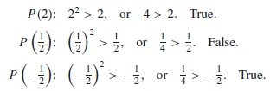
Example
Let P(x) be the predicate “x² > x” with domain the set R of all real numbers. Write P(2), P( 1/2 ), and P(−1/2 ), and indicate which of these statements are true and which are false.

Slide 8
Example: Truth Set
Let Q(n) be the predicate “n is a factor of 8.” Find the truth set of Q(n) if
a. the domain of n is the set Z⁺ of all positive integers
b. the domain of n is the set Z of all integers.
Solution: a. The truth set is {1, 2, 4, 8} because these are exactly the positive integers that divide 8 evenly.
b. The truth set is {1, 2, 4, 8,−1,−2,−4,−8} because the negative integers−1,−2,−4,and −8 also divide into 8 without leaving a remainder.

Slide 9
Binding variables of predicates
1 - By substitution (giving a value to the variable)
For example, using the predicate:
P(x)= x² > x
P(2)= 2² > 2
2 - By quantification
A quantifier is a mechanism for specifying an expression about a set of values.

Slide 10

Universal quantifier: $∀$
Let Q(x) be a predicate and D the domain of x. A universal quantified statement is a statement of the form “∀x ∈ D, Q(x).”
It is defined to be true if, and only if, Q(x) is true for every x in D. It is defined to be false if, and only if, Q(x) is false for at least one x in D.
A value for x for which Q(x) is false is called a counterexample to the universal statement.

Slide 11
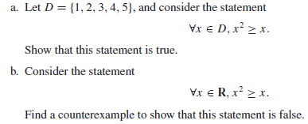
Exercise

Slide 12
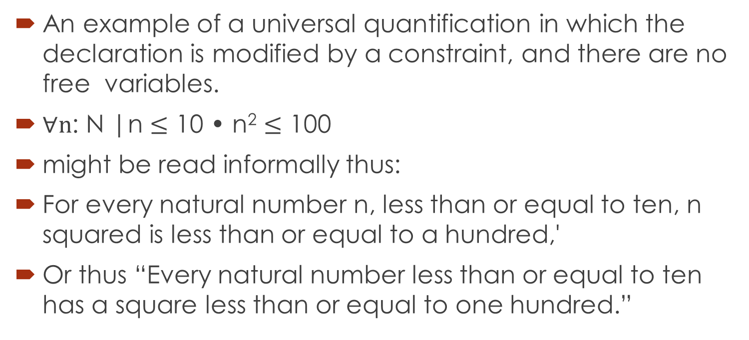
Example
An example of a universal quantification in which the declaration is modified by a constraint, and there are no free variables.
$∀n$: N |n $≤$ 10 • n² $≤$ 100
might be read informally thus:
For every natural number n, less than or equal to ten, n squared is less than or equal to a hundred,'
Or thus “Every natural number less than or equal to ten has a square less than or equal to one hundred.”

Slide 13
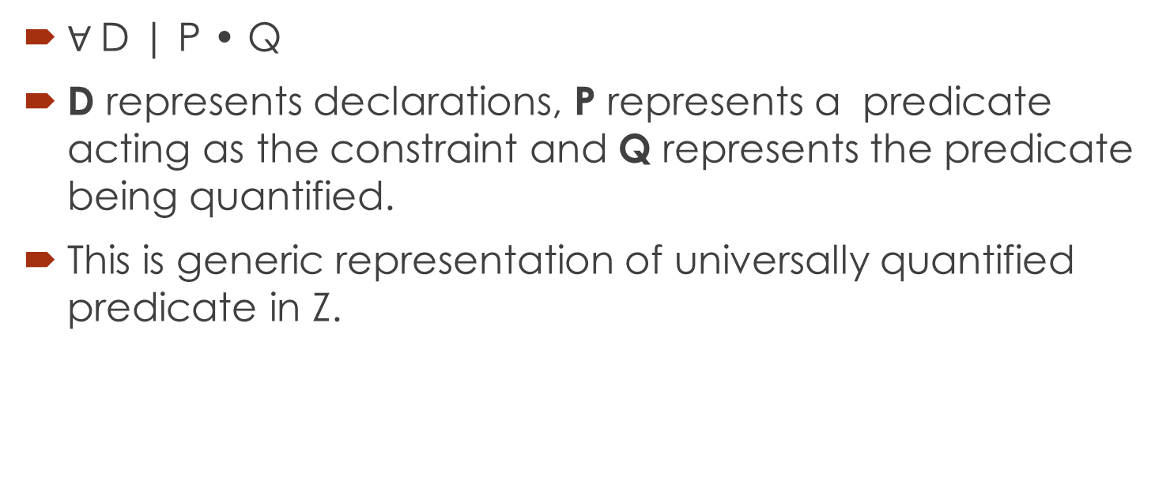
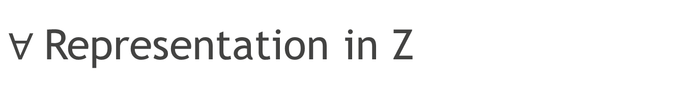
$∀$Representation in Z
$∀$D | P • Q
D represents declarations, P represents a predicate acting as the constraint and Q represents the predicate being quantified.
This is generic representation of universally quantified predicate in Z.

Slide 14
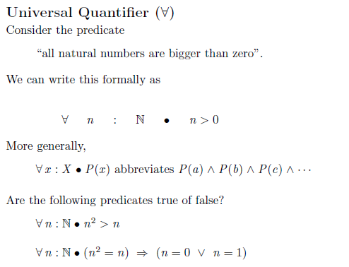
Universal quantifier: $∀$

Slide 15
Implicit quantification
Observe that the two statements “∀ real numbers x, if x is an integer then x is rational” and “∀ integers x, x is rational” mean the same thing. Both have informal translations
“All integers are rational.” In fact, a statement of the form
∀x : U • if P(x) then Q(x) can always be rewritten in the form
∀x : D • Q(x)
by narrowing U to be the domain D consisting of all values of the variable x that make P(x) true. Conversely, a statement of the form ∀x ∈ D, Q(x) can be rewritten as
∀x, if x is in D then Q(x).

Slide 16
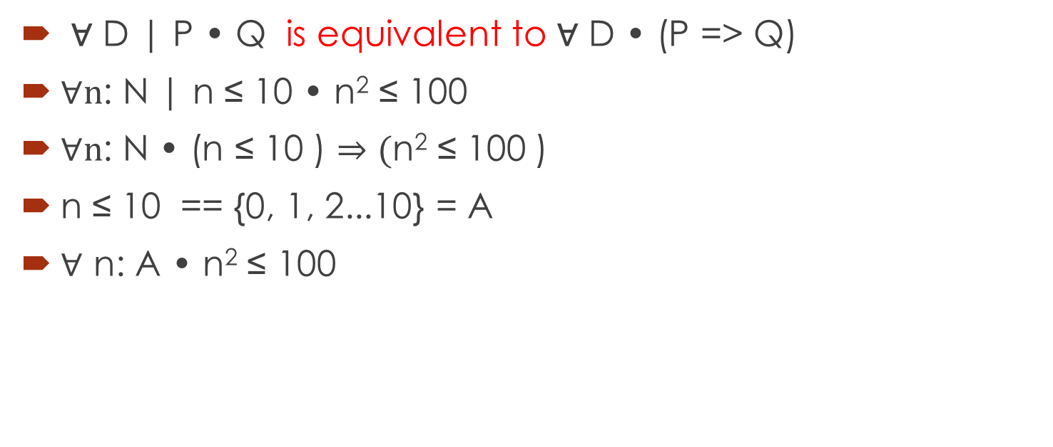
Example of implicit quantification
∀ D | P • Q is equivalent to ∀ D • (P => Q)
$∀n$: N | n ≤ 10 • n² ≤ 100
$∀n$: N • (n ≤ 10 ) $⇒(\text{n}\text{2} \text{≤}\text{ 100 }$)
n ≤ 10 == {0, 1, 2...10} = A
$∀$ n: A • n² ≤ 100

Slide 17
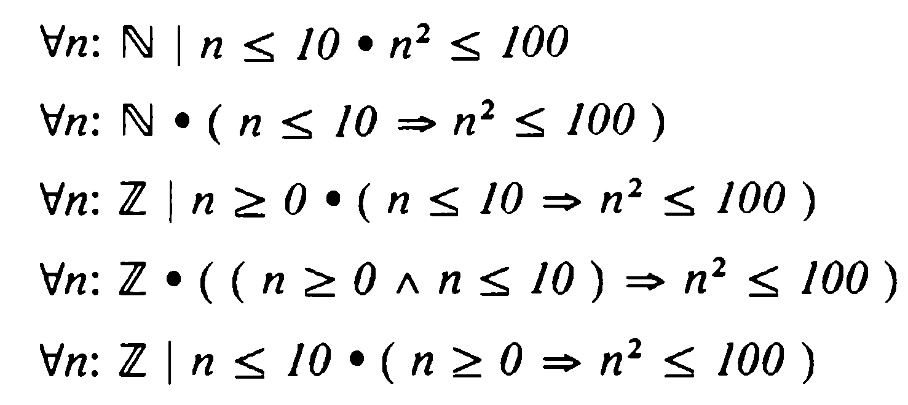
Different form of universal quantification

Slide 18
The Existential Quantifier: ∃
Let Q(x) be a predicate and D the domain of x. An existential statement is a statement of the form “∃x ∈ D such that Q(x).”
It is defined to be true if, and only if, Q(x) is true for at least one x in D. It is false if, and only if, Q(x) is false for all x in D.

Slide 19
Quantified Predicate with free variable
Whether the existential quantification
ꓱy: Z • x = y²
is true depends only on the choice of a value for x, so x is still free in the existential quantification.
If we choose 4, it is true; if we choose 73, or -14, it is false.
Therefore, ꓱy: Z • x = y² is not a statement but predicate due to the free variable which is not bounded by the quantifier.

Slide 20
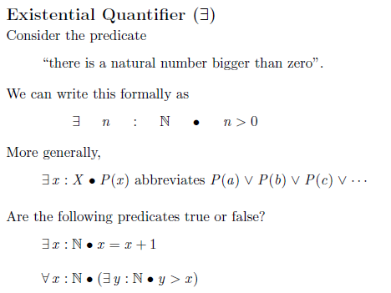
Existential quantifier in Z

Slide 21
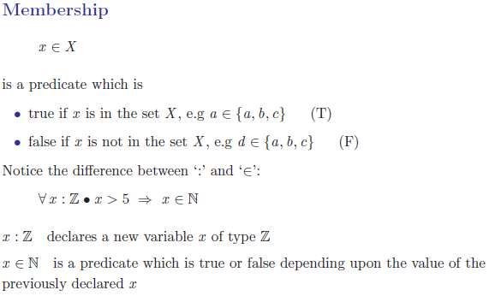
Membership quantification

Slide 22
Existential quantification
An existential quantification with a constraint can be recast in various ways.
∃ D | P • Q
is equivalent to
∃ D • (P ^ Q)

Slide 23
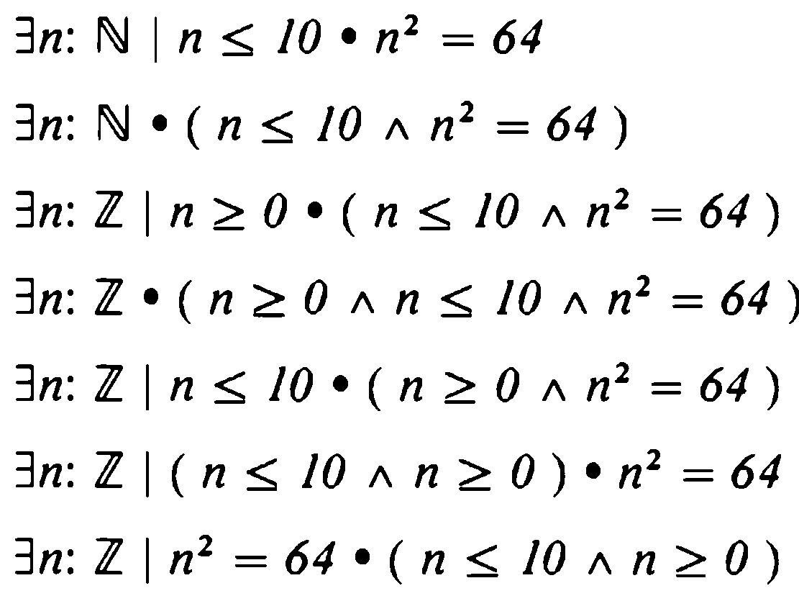
Alternative forms of existential quantifier

Slide 24
Unique existential quantifier
The unique existential quantifier allows us to introduce a notation to formalize the informal notion of there being only one thing of a certain kind.
The sign ∃₁ is called the unique existential quantifier, and this whole predicate is called a unique existential quantification. The heavy dot and constraint bar might also appear. The general form is ∃₁ D|P ● Q

Slide 25

Example
For instance to say that there is exactly one integer greater than zero whose square is one hundred, we might write
∃₁ x : Z • x > 0 $∧$x² = 100

Slide 26
Negation of universally quantified statement
There is a relationship between universal and existential quantification. Universal quantification expresses a property of all objects in a class while existential quantification asserts at least one object in a class has a property.
An assertion that not all objects in a class have a particular property is also an assertion that at least one object in the class does not have the property. Formally, this means that

Slide 27
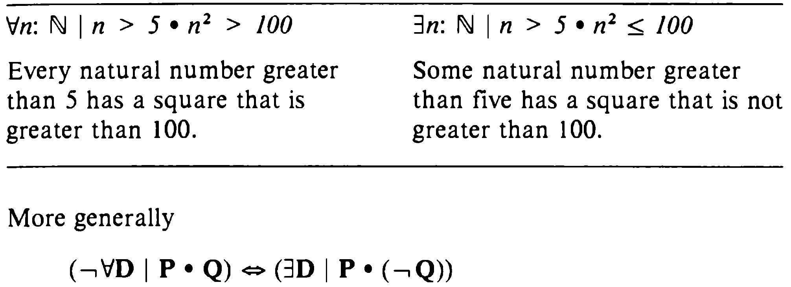
Example: Negation of quantified statements

Slide 28
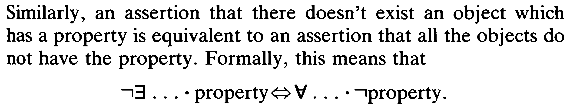
Negation of existential quantified statement

Slide 29
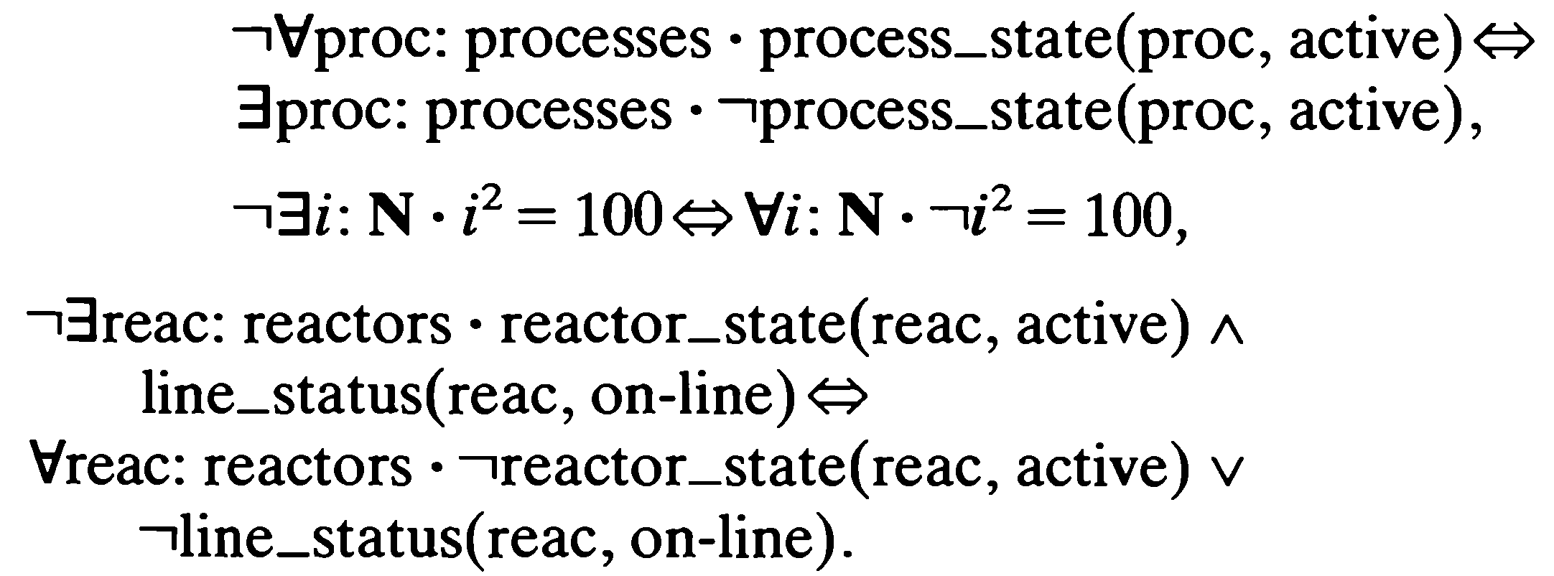
Examples

Slide 30
Summary of the lecture: conclusion
Predicates
Quantified statements
Negation of quantified statement

Slide 31
Reference and reading material
Chapter # 3: Section 3.3 of the book “Software development with Z” by J.B. Wordsworth
Chapter # 2: of the book “Formal Software Development, from VDM to Java” by Quentin Charatan and Aaron Kans

